Slide 1
Empathy Scales
A Multi-Agent LLM-Based Empathy Assessment Scale Generation System for Robots.
Group 1
Payne Li； Wentao Zhao；Donghua Cai

Slide 2
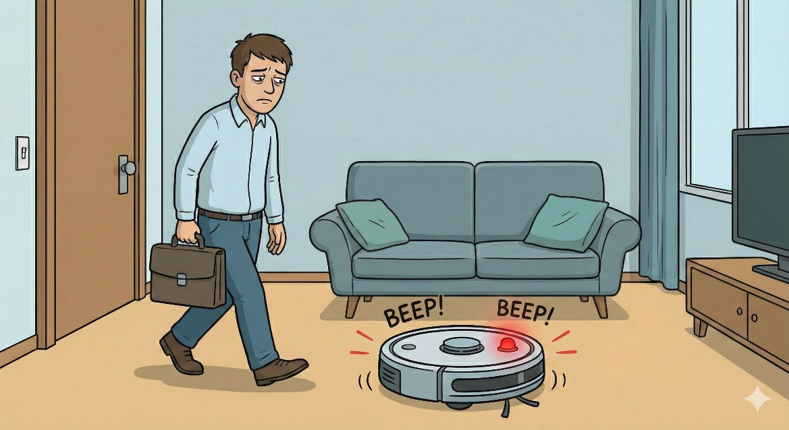
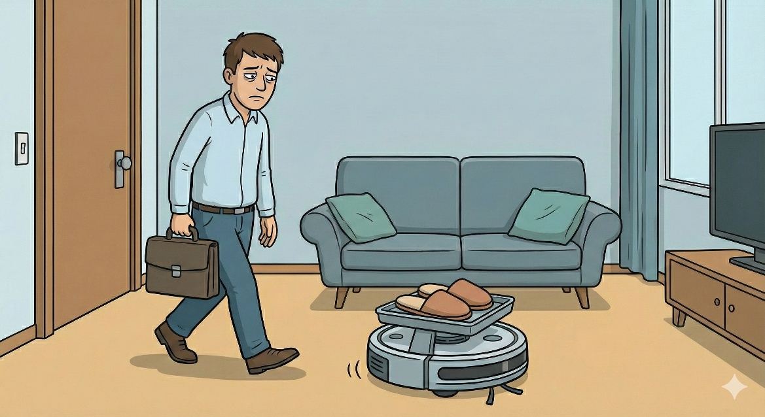
Empathy Scales- Intuition
Robot Empathy is not about having feelings, but the ability to perceive human states and adapt behavior.
Demonstrate empathy is critical for trust and effective collaboration.
How can we quantitatively measure this empathy？
Notes:
Good morning, everyone. We are Team One. To introduce our project, I want you to imagine coming home after a long, stressful day. You are tired and frustrated.
Now, look at this home service robot. [Show Image 3: Annoying Robot] Does it just loudly beep at you, completely ignoring your mood and adding to your stress?
[Advance to Image 4: Helpful Robot] OR, does it notice you are tired, quietly stay out of your way, and anticipate your needs—perhaps bringing you your slippers?
This difference is what we call 'Robot Empathy'. It’s not about robots having feelings. It’s about robots perceiving your human state and adjusting their behavior to support you.
This leads to the core intuition of our project: How can we quantitatively measure this empathy? We need a metric to confirm why the second behavior is better than the first, and to guide engineers in building robots that become increasingly better at supporting us.

Slide 3
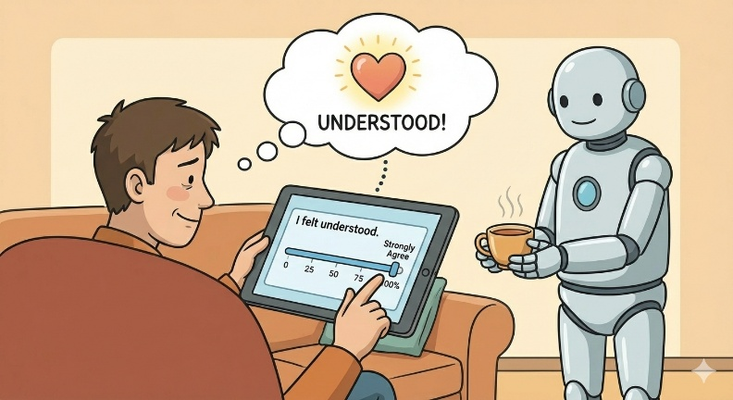
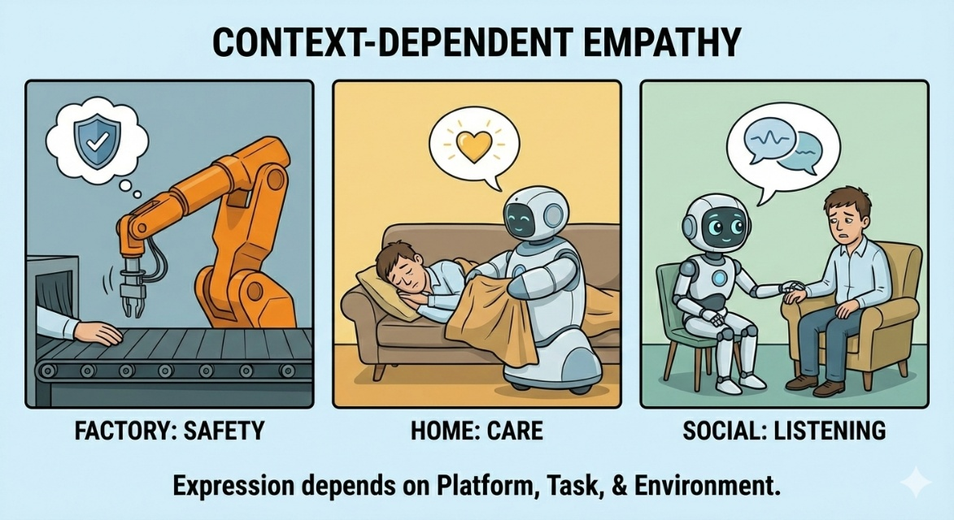
Related Work & Problem Statement
Perceived Empathy = Human-Robot Interaction + Subjective Feedback
Existing Scales: Too Generic
PETS(Schmidmaier et al., CHI 2024, based on 9-Step)
RoPE(Charrier et al., HRI 2019, based on Human scales)
Classic Methods: Too Slow
Boateng Nine-Step Method(Boateng et al., 2018)
involving too many human participants
OURS: high-quality, scenario-specific empathy scales through Multi-Agent LLM
Notes:
To measure robot empathy, we rely on Perceived Empathy—asking users how they feel via questionnaires, after interacted with robot.
But we face a dilemma. Existing generic scales, like PETS and RoPE, are often too broad. They ask: 'Did the robot understand me?' But this misses the details. Empathy for a factory arm means safety, while for a home robot, it means care. As we can see, the expression of empathy highly depends on the platform, the task, and the environment.
To capture these differences, we need custom scales.
The widely accepted standard for developing them is the Boateng Nine-Step Method. While rigorous, this manual process is slow and costly, often taking months to complete.
This is our opportunity. Inspired by Multi-Agent systems, our goal is to automate this rigorous framework. We aim to generate high-quality, scenario-specific scales in hours, not months.

Slide 4
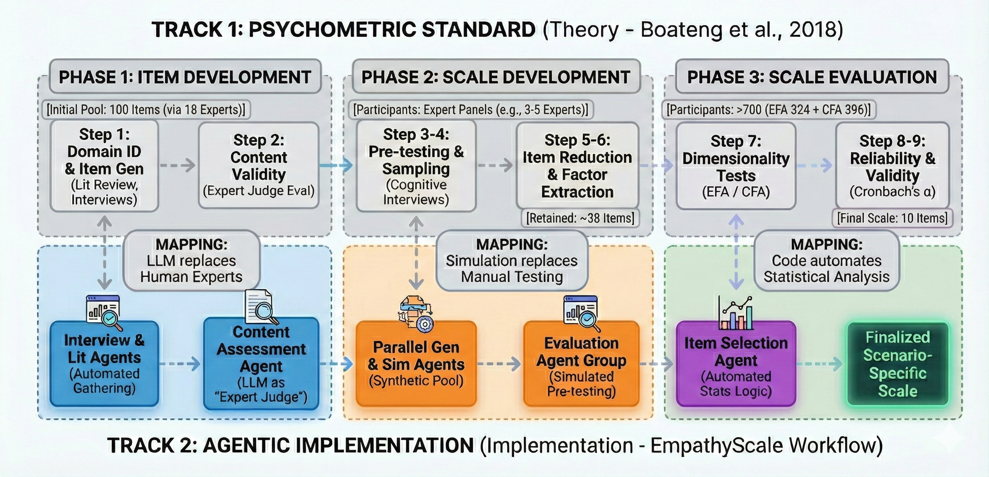
Framework & Workflow
Notes:
Look at the top track. This is the traditional way. It’s rigorous, but incredibly heavy on human resources. Take the PETS scale (published in CHI 2024) as a prime example of this standard:
For Phase 1 (Item Development): The authors didn't just write questions. They interviewed 18 experts to generate an initial pool of 100 items. Then, expert panels filtered these down to 38 candidates.
For Phases 2 & 3 (Scale Evaluation): To statistically validate those items, they couldn't just guess. They had to recruit 324 participants for the first round (EFA) and another 396 participants for the second round (CFA) to finally reach their 10-item scale.
Coordinate 30 experts, recruit over 700 participants, and analyze data for months—that is the cost of rigor.
[配合动作：手势指向图表下半部分 (蓝色区域 - Practice)]
Now, look at our bottom track. We mapped those exact steps to AI Agents, operating at a massive scale:
Instead of interviewing 18 experts, our Generator Agents instantly create a massive pool of [e.g., over 100] initial items*.
Instead of human panels, our 'Expert Judge' Agent rigorously filters this pool down to the best [e.g., 40] candidates* based on strict criteria.
Instead of recruiting 700 humans, we deploy [e.g., 300] distinct simulated Personas* to instantly generate the statistical data needed for EFA and CFA.
[Summary] We maintain the scientific rigor of the Boateng method, but we compress the timeline from months to hours."

Slide 5
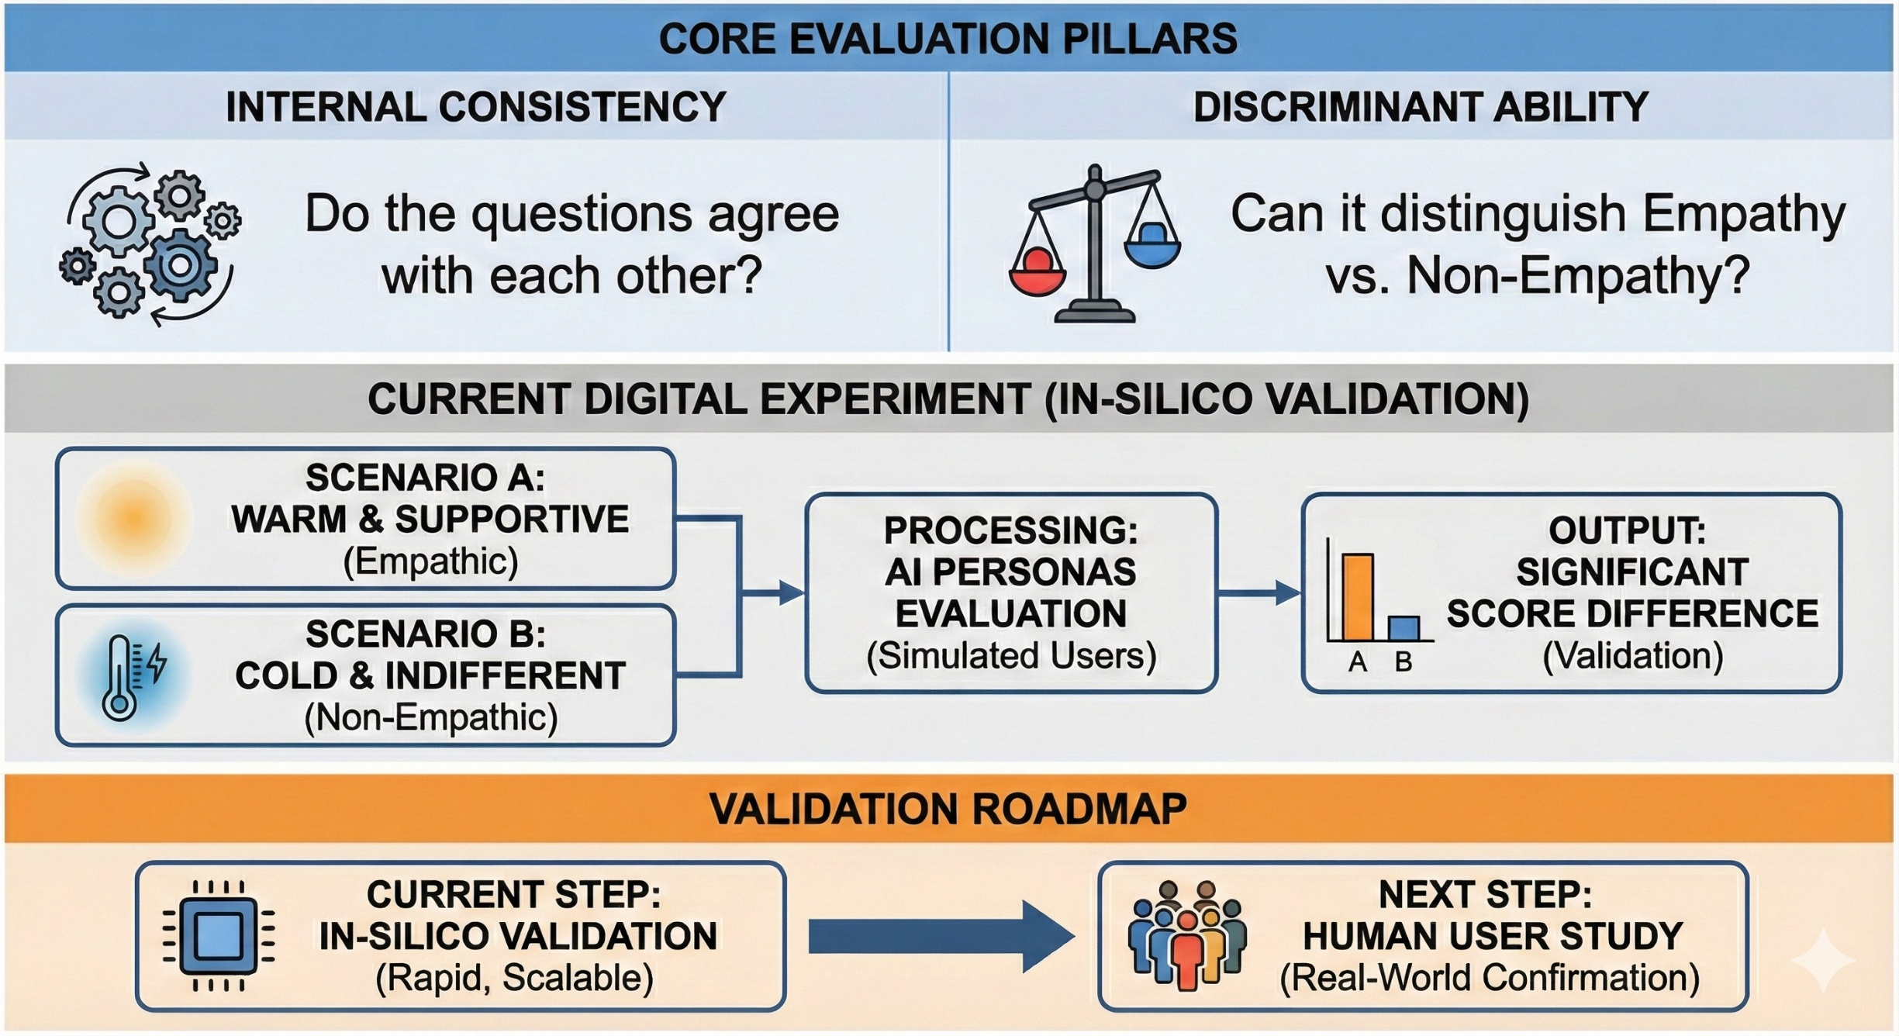
Framework & Workflow
Notes:
"So, how do we evaluate if our generated scale is actually effective? Currently, we focus on two simple but critical criteria to validate our initial version.
[Gesture: First finger] First is Internal Consistency. In plain English, this checks: Do the questions agree with each other? If a user rates the robot as 'kind', they should also rate it as 'caring'. If the answers contradict each other, the scale is unstable.
[Gesture: Second finger] Second is Discriminant Ability. This is the sensitivity test: Can the scale actually tell the difference between an 'empathic' robot and a 'non-empathic' one?
[Gesture: Point to the bottom experiment diagram] To test this without waiting months for a user study, we designed a Digital Control Experiment:
We generated two interaction histories: one where the robot is Warm and Supportive, and one where it is Cold and Indifferent.
Then, we had our Simulated Personas evaluate both using our scale.
[Tone: Humble and Objective] If the scale is valid, it must give significantly different scores to these two scenarios. While we are using this In-Silico approach for rapid, high-volume validation right now, we fully recognize that a Human User Study will be the essential next step to confirm these findings in the real world."

Slide 6
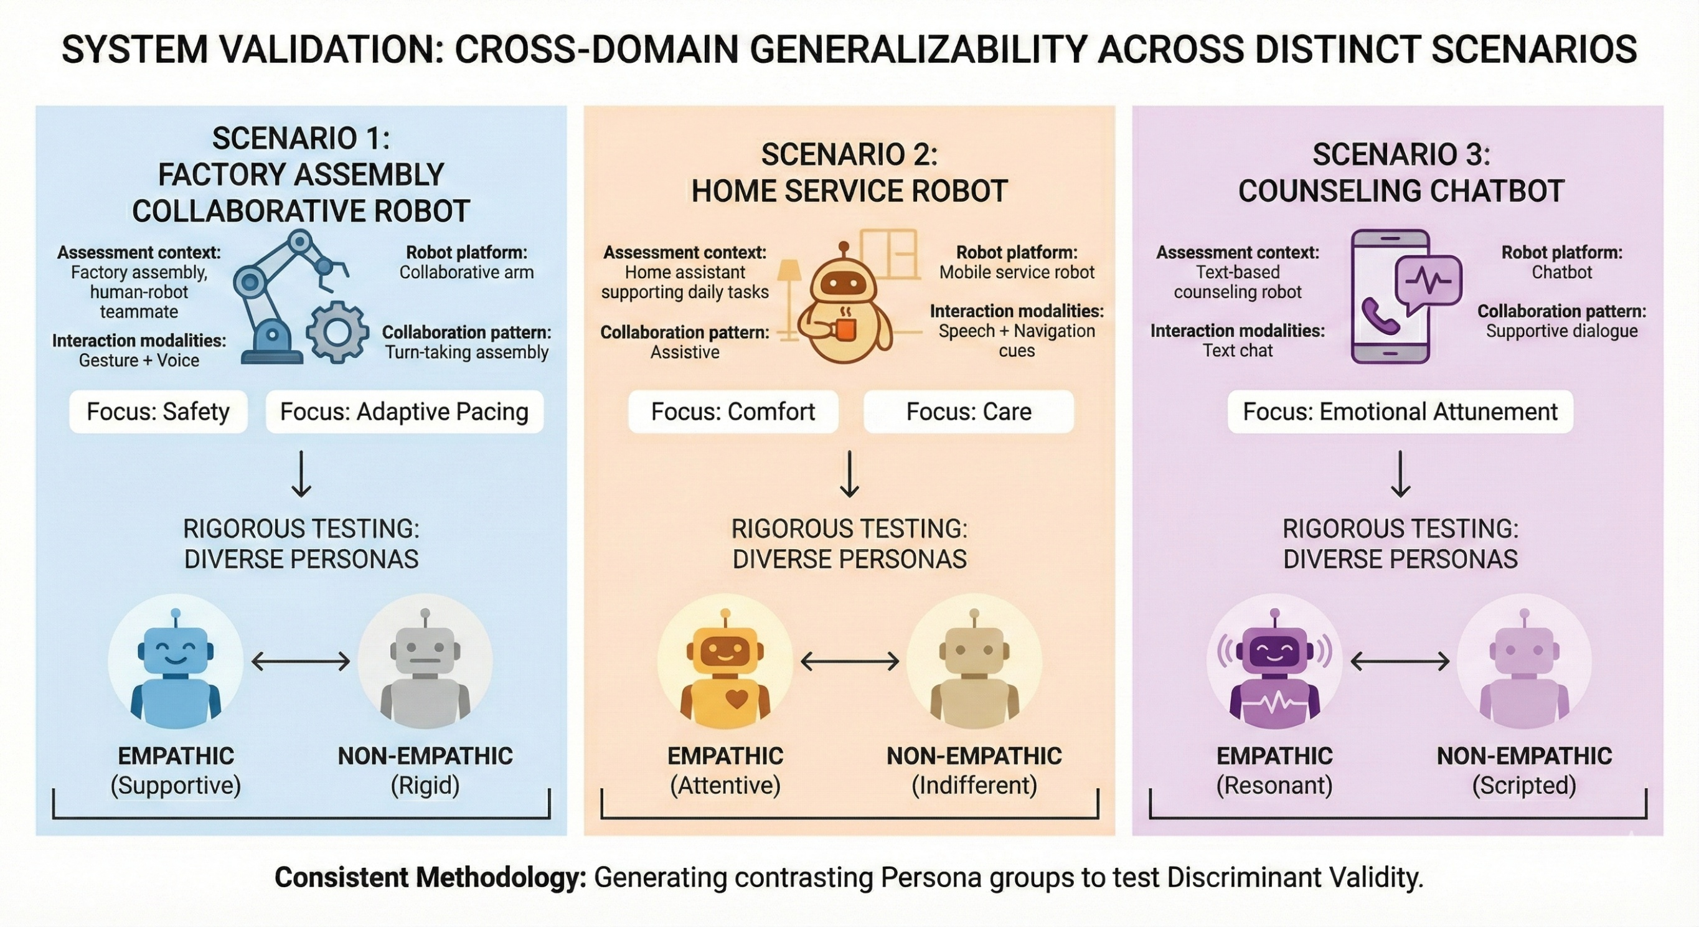
Experimental Setup - Scenarios
Notes:
"To ensure generalizability, we validated our system across three distinct domains:
[Gesture: Left, Middle, Right]
Industrial: A collaborative arm in a factory, where empathy translates to Safety and Adaptive Pacing.
Domestic: A mobile home robot, focusing on Comfort and Care.
Clinical: A text-based counseling chatbot, prioritizing Emotional Attunement.
[Summary] From heavy machinery to text therapy, we deployed 'Empathic vs. Non-Empathic' scenarios in each context, proving our scale works regardless of the platform."

Slide 7
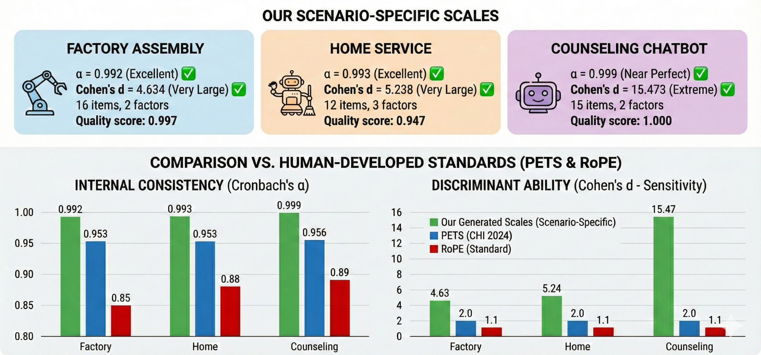
Performance Benchmark:
Outperforming the Gold Standard
Notes:
[Gesture to top row scenarios] "We validated our system across Factory, Home, and Counseling scenarios. As shown at the top, every generated scale achieved excellent quality scores."
[Gesture to bottom charts] “Comparing this to the human gold standard, PETS (shown in blue) and RoPE (shown in red）:"
[Gesture to bottom-left chart] "On the left, for Reliability, we consistently stay above 0.99, significantly outperforming the baseline."
[Gesture to bottom-right chart] "On the right, for Sensitivity, while standard scales hover around 2.0, we reached 4.6 in Factory, and a massive 15.4 in Counseling."
[Face audience] "This confirms that scenario-specific generation is far superior to generic human scales."

Slide 8
Item Comparison: (A Qualitative Look)
Why Scenario-Specific Scales Matter
PETS (CHI 2024) - General Purpose
Focus: Broad emotional concepts & general trust
Factor 1: Emotional Responsiveness
E1: The system considered my mental state.
E2: The system seemed emotionally intelligent.
E3: The system expressed emotions.
E4: The system sympathized with me.
E5: The system showed interest in me.
E6: The system supported me in coping with an emotional situation.
Factor 2: Understanding and Trust
U1: The system understood my goals.
U2: The system understood my needs.
U3: I trusted the system.
U4: The system understood my intentions.
OURS (Generated by MA-LLM) - Factory Context
Focus: Concrete actions, safety, and task collaboration
### Proactive Support and Guidance (11 items)
- Item 1: The robot proactively suggested solutions to problems.
- Item 2: The robot provided timely help during complex tasks.
- Item 3: The robot checked in on my progress regularly.
- Item 4: The robot offered assistance without me needing to ask.
- Item 5: The robot helped me regain focus when I lost track.
- Item 6: The robot ensured I had everything I needed to succeed.
- Item 7: The robot's support made me feel safer at work.
- Item 8: The robot comprehended the specific tasks I prioritized.
- Item 9: The robot understood both my short-term and long-term goals.
- Item 10: The robot adapted its approach based on my feedback.
- Item 11: The robot interpreted my signals about task completion.
### Emotional Awareness and Support (5 items)
- Item 12: The robot's actions showed it understood my emotional state.
- Item 13: The robot showed awareness of my stress levels.
- Item 14: The robot recognized when I needed encouragement.
- Item 15: The robot's responses felt attuned to my mood.
- Item 16: The robot encouraged me to keep going when I hesitated.
Notes:
As you can see, PETS relies on abstract concepts like 'sympathizing' or 'showing interest.' While valid, it's vague for a factory worker. Our generated scale translates empathy into concrete actions: ensuring safety, proactively solving problems, and checking progress. This specific granularity leads to the higher construct validity we saw in the previous slide."

Slide 9
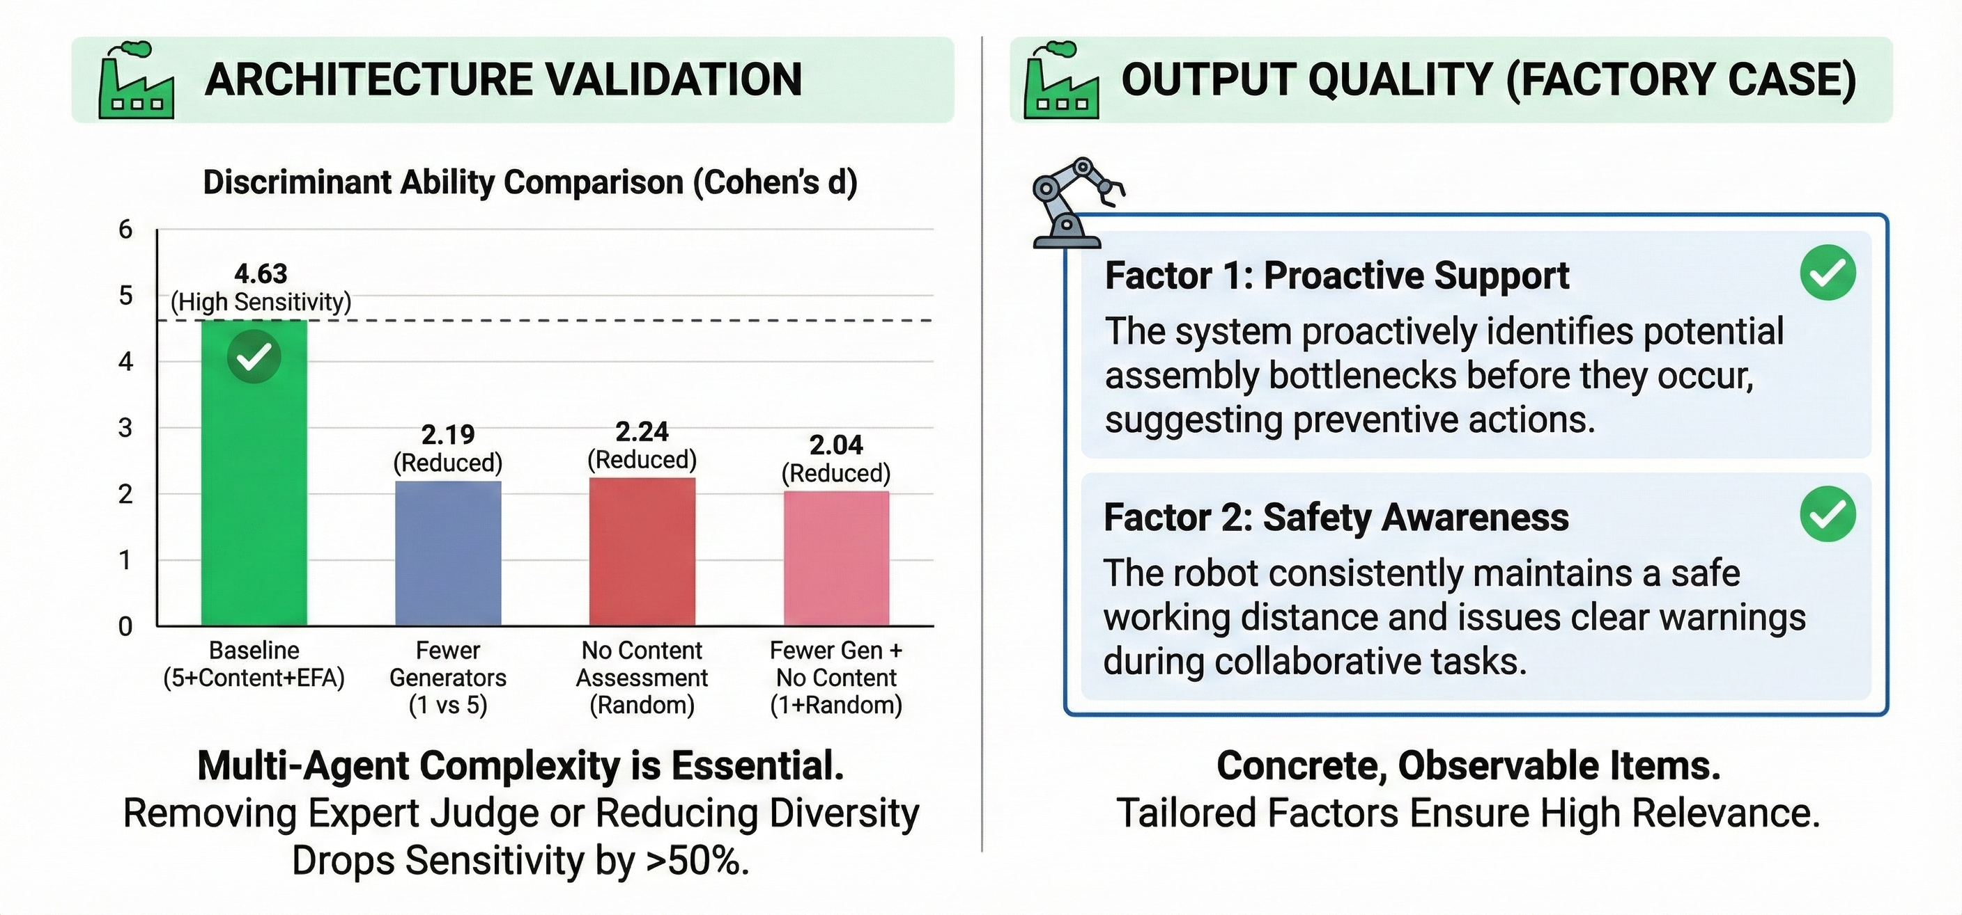
Mechanism & Output: Why Complexity Matters
Notes:
So, why is our performance so high? We answer this through Architecture and Content.
[Gesture to Left Chart - Ablation] On the left, our Ablation Study proves that our Multi-Agent complexity is essential. When we removed the 'Expert Judge' or reduced the diversity of Generators, the scale's sensitivity dropped by over 50% (from 4.6 down to ~2.2). This confirms that our rigorous filtering process is the key to quality.
[Gesture to Right Section - Case Study] On the right, you see the result: Concrete, Observable Items. In the Factory scenario, the system didn't generate generic fluff. It identified specific factors like 'Proactive Support' and 'Safety Awareness', ensuring the scale is tailored exactly to the collaborative task."

Slide 10
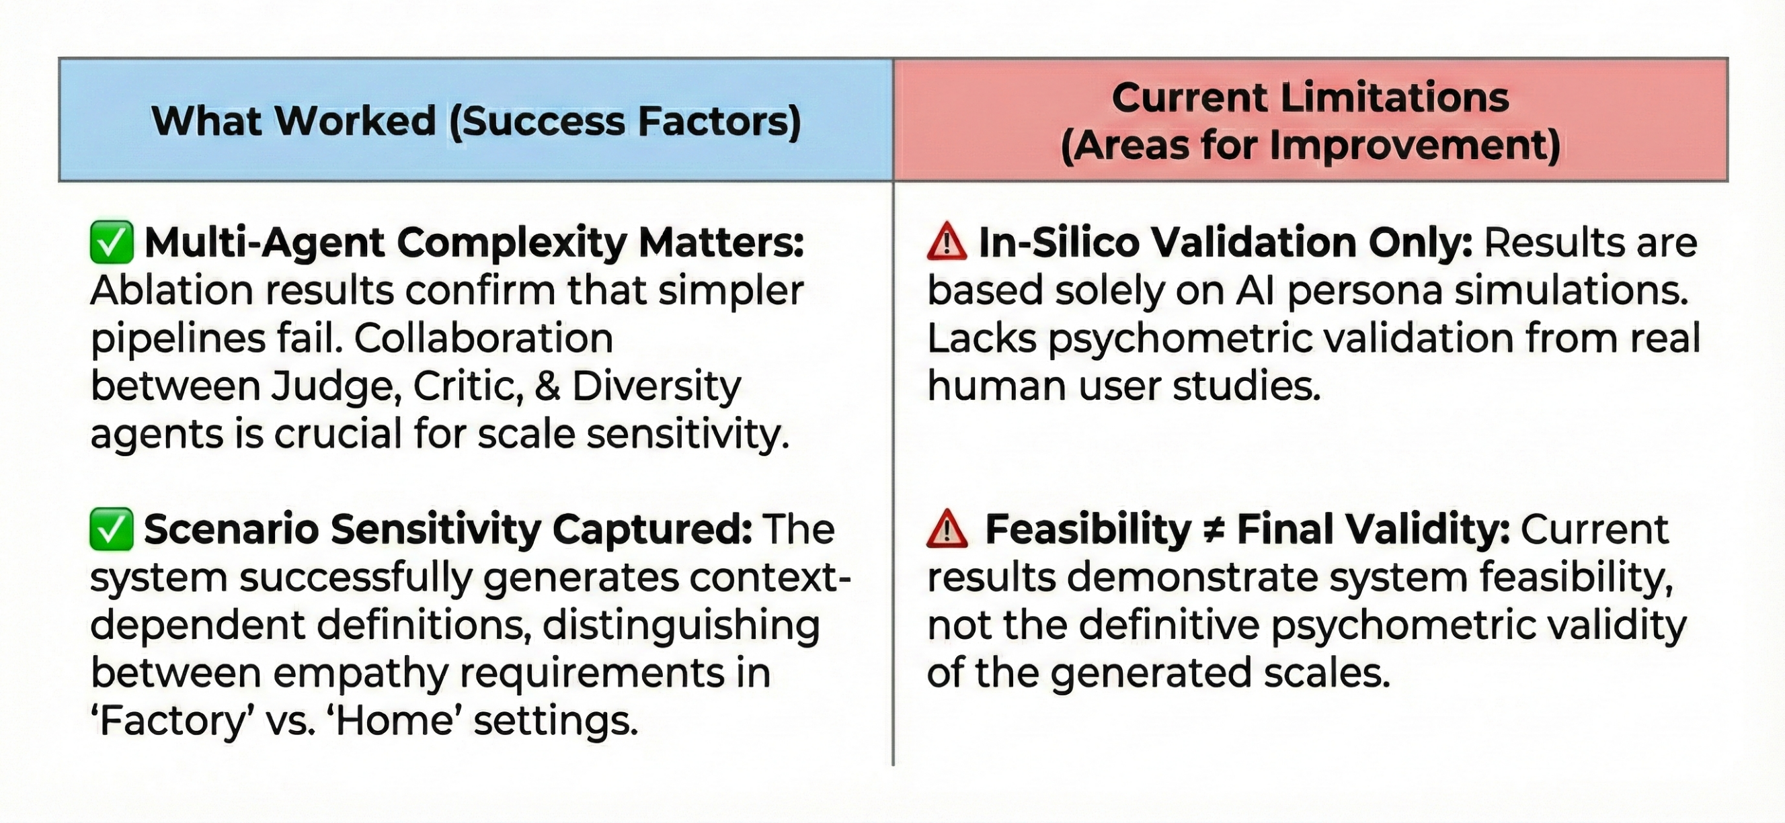
Key Insights & Limitations
Notes:
"Moving to insights: First, Complexity is vital. Our tests showed simple models fail; only the multi-agent collaboration achieves the necessary sensitivity. Second, Context works. The system correctly identifies that 'empathy' means safety in factories, but care at home.
The Limitation? It's currently simulation-only. We have strong feasibility signals from AI personas, but we still lack real-world human validation. That is our next step."

Slide 11
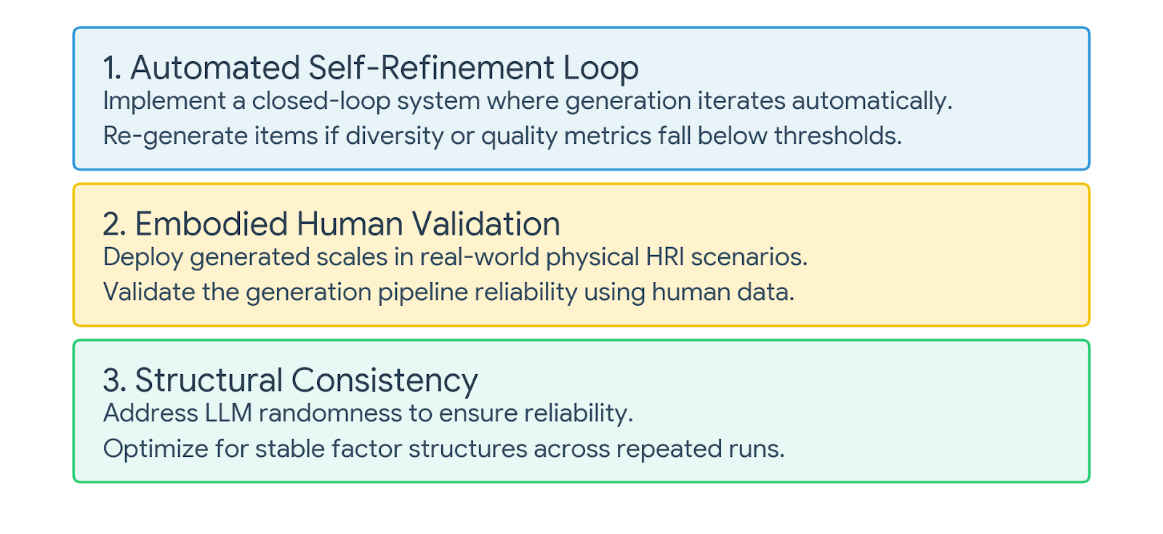
Future Work:
Refinement, Validation& Stability
Notes:
"Finally, we have identified three key directions to mature this work:
First is Self-Refinement. currently, our generation is a one-pass process. We plan to add a feedback loop. If the generated items don't meet our diversity or quality metrics, the system should automatically reject and re-generate them until they are perfect.
Second is Embodied Validation. We need to prove this tool works in reality. We will conduct user studies with physical robots in the specific scenarios we defined. By comparing human feedback against our system's output, we can validate that this method of generating scales is reliable for real-world HRI.
Third is Consistency. Since LLMs can be stochastic, we aim to improve the system's stability, ensuring that if you run the same scenario twice, you get a structurally consistent scale, which is crucial for standardizing research tools.
Thank you for listening, and we are happy to take any questions."

Slide 12
Thanks！

Slide 13
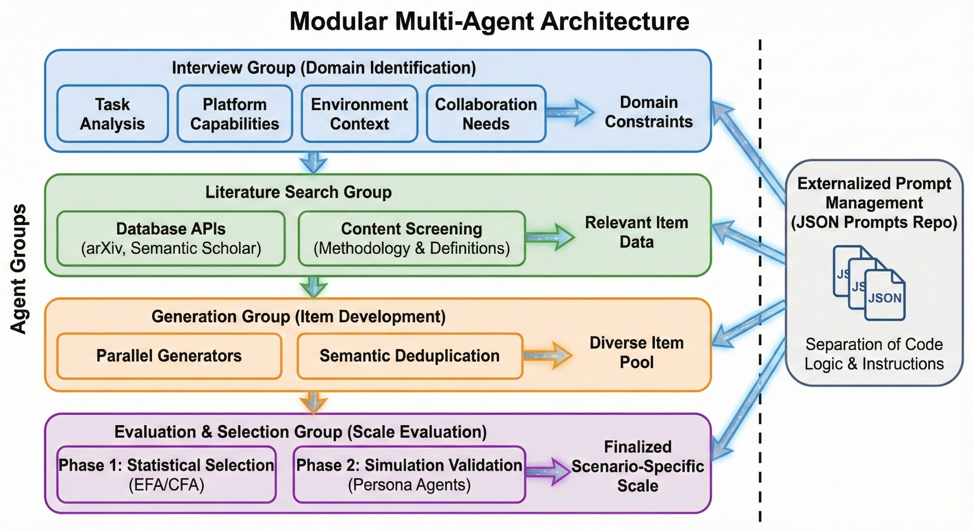
Notes:
First, let's look at the engineering behind EmpathyScale. We built a Modular Multi-Agent Architecture. Instead of a single black-box model, we use specialized Agent Groups—like 'Interview' or 'Literature Search'—each containing sub-agents for specific tasks.
Crucially, we implemented Externalized Prompt Management. We separate the code logic from the prompt instructions, storing all prompts in external JSON files. This ensures our system is not just a demo, but a robust, maintainable software framework.

